Slide 1
Week 1: Tutorial
6CS030-Big Data
Introduction to Big Data

Slide 2
Module Assessments
ASSESSMENT | DESCRIPTION | % COVERAGE
Coursework | Implementation based research work involving handling and analysing of big data in your interest specific subject domain. | Report (80%) Code (20%) out of total 70%
Timed Constrained Assessment. | MCQ Exam based on Big Data subjects covered over the weeks. | 30%

Slide 3
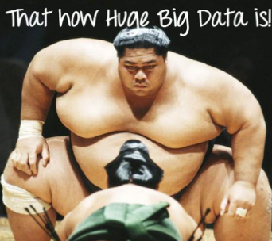
Why the term Big Data?
Because its data that is higher in volume as its exponentially growing & complex in nature.
Given the nature, it gets difficult to be handled using
Traditional Data Management Tools.
Example : Excel, RDMS management systems.
Some Examples :
Data Ingested in Popular Social Media Platforms.
But what makes it Big Data and not just Data ?
BIG DATA
DATA

Slide 4
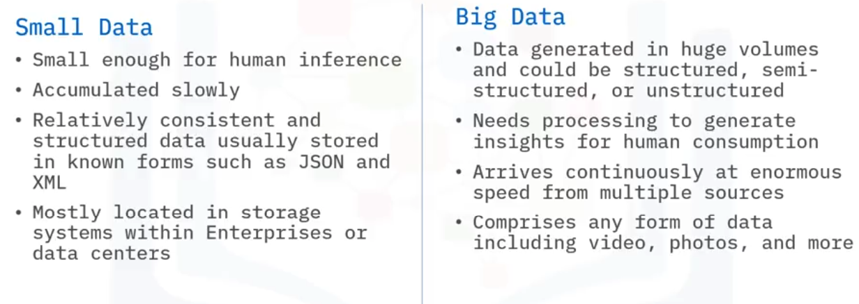
BIG DATA VS. SMALL DATA

Slide 5
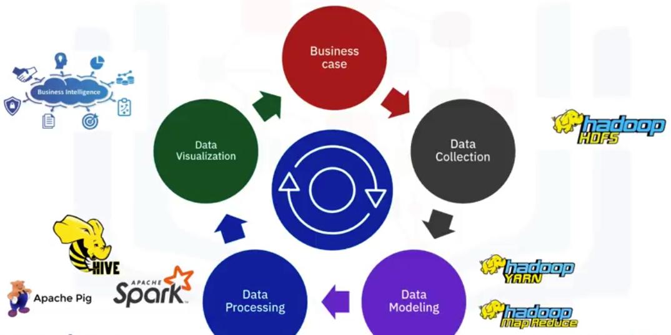
BIG DATA LIFE CYCLE

Slide 6
CHARACTERISTICS OF BIG DATA
The 5Vs
Volume
Value
Variety
Velocity
Veracity

Slide 7
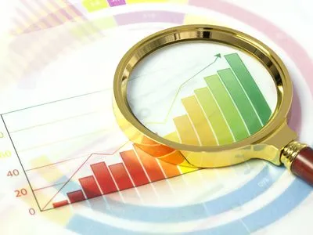
VOLUME
The amount of data generated every second.
Its volume ranges from Petabytes to Zettabytes or Exabytes.
High volume leads to high system configuration to process this volume for effectiveness.

Slide 8
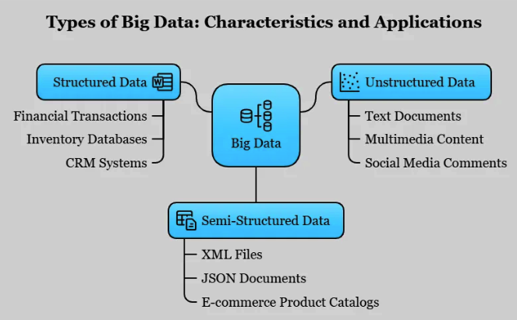
VARIETY
Big Data unlike traditional structured format can come in many forms.
Given the variety of dataset it can be heterogeneous, complex, incompatible.
It is also variable in nature.

Slide 9

VALUE
It refers to the benefits the retrieved data can provide.
The value of big data is related to the amount of insights that can be gained from it.
It is also measured with an estimation made based on the positive impacts it helps to bring in a subject.

Slide 10
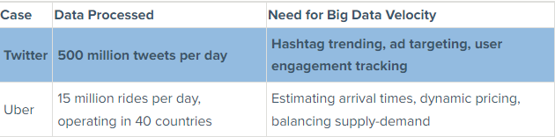
VELOCITY
This refers to the rate at which the data is being generated or renewed.
And at what rate it moves from various source to data repositories.
Larger Velocity refers to high volume of data and an effective measure for managing massive volumes of data.
High velocity of the data demands adequate processing strategies for timely insight generation.

Slide 11

VERACITY
It refers to the certainty or reliability factor of a data.
The accuracy with which it represents the real-world scenarios play an important role.
With data changing every millisecond, it is important that it is obeys the timeliness too. (Upto date data) .
Noise in data affects its veracity.
Notes:
test

Slide 12
Big Data Statistics
45% of IT professionals anticipate the usage of several technologies-including 5G, edge computing and machine learning to manage data. (Dell Technologies)
Netflix saves $1 Billion per year with the usage of Big Data for extraordinary customer retention.
70% of the world’s data is user-generated.
~570 new websites spring into existence every minute every day.
Google alone processes 40k search queries per second.
~100 hours of videos are uploaded to Youtube every minute.
More data has been created in the past 2 years than the entire previous history of human kinds.

Slide 13
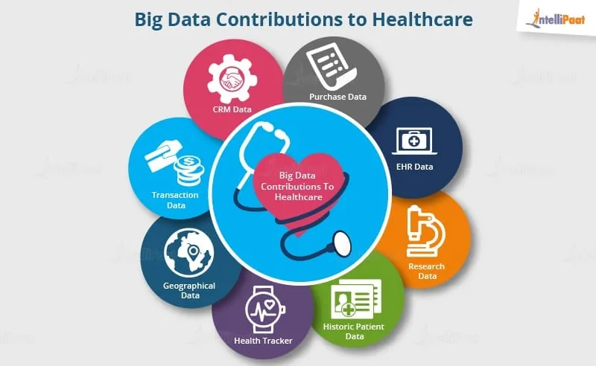
BIG DATA APPLICATION IN HEALTHCARE

Slide 14
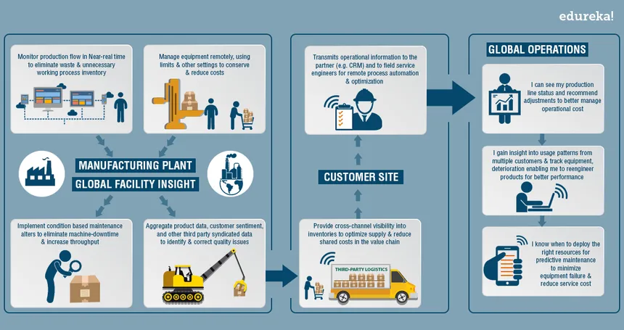
BIG DATA APPLICATIONS IN MANUFACTURING

Slide 15
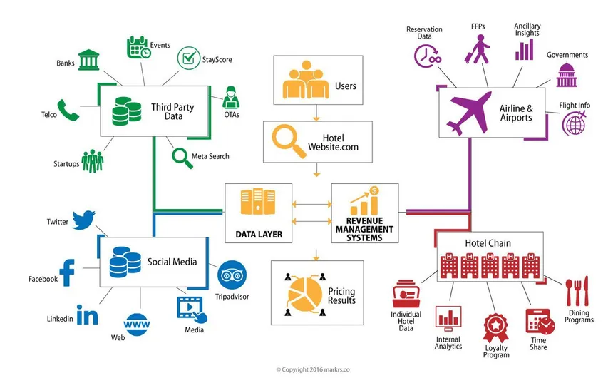
BIG DATA APPLICATIONS IN AIRLINES

Slide 16
CHALLENGES OF BIG DATA
Storage Contrataints Scalable Infrastructure
Real Time Analysis Investing in Real-Time Analytics with tools like Apache Spark
Data Value Data Preprocessing through partitioning, cleaning and memory management
Unproportionate Demand & Talent Ratio Awareness & Education in Big Data Analytics

Slide 17
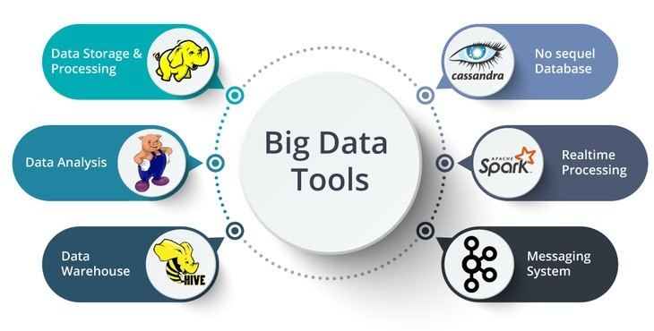



TOOLS & TECHNOLOGIES USED IN BIG DATA

Slide 18
Big Data Ecosystem
Data Technologies (Hadoop, HDFS, MapReduce,Spark etc.)
Analysis and Visualization (Tableau, Apache Pig,TeraData etc.)
Business intelligence (PowerBI, Business Objects etc.)
NoSQL databases(MongoDB, CouchDB, Redis etc.)
Programming Tools (R, Python, SQL,Julia etc.)
Cloud Service Providers (AWS, IBM, GCP, Oracle etc.)

Slide 19
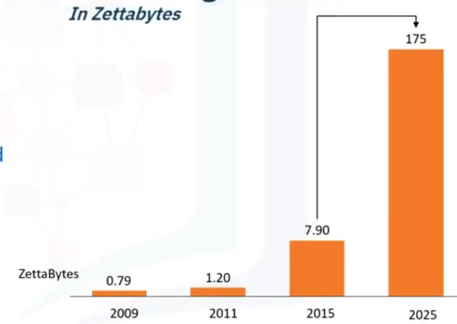
Growth in Global Data

Slide 20
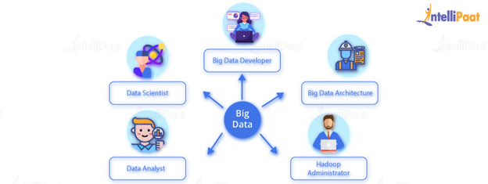
CAREERS WITH BIG DATA ANALYTICS

Slide 21
So, what’s up for workshop this week?

Slide 22
Remember Python ?
We will explore Python for data handling and explore its use cases because Python provides following benefits in Big Data
Ease of Use : First things first, its super easy and comprehensible
Rich Ecosystem : Diverse libraries for handling data kinds and situations. Example : PyMongo, Pyspark.
Flexible Integration : Its rich ecosystem allows its integration with variable data pipelines and databases envs.

